Slide 1
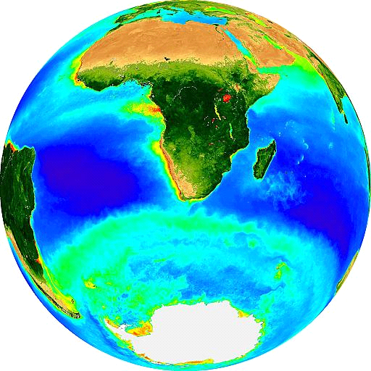
Marine Carbon Cycle II
Dr. Sarah Fawcett
sarah.fawcett@uct.ac.za
Katye Altieri
26 May 2017

Slide 2
2) Biological carbon pump
The photosynthetic production, sinking, and deep ocean decomposition of organic matter that cause a vertical gradient of dissolved inorganic carbon (DIC) in the ocean, in net causing the storage of CO₂ in deep waters and thus lowering atmospheric CO₂.
In some cases, the biological pump is taken to involve two components: (1) the rain of soft tissue organic carbon from the surface to depth, the “soft tissue pump”, and (2) the rain of mineral calcium carbonate from the surface to depth, the “carbonate pump”. The former (1) lowers atmospheric CO₂, while the latter (2) raises it.
Notes:
Reminder of our definition of the biological carbon pump, which consists of the soft tissue pump and the carbonate pump. You could ask them to tell you what the soft tissue pump is again. The important thing is that while the soft tissue pump lowers atmospheric CO2, the carbonate pump actually raises it. How does that work?

Slide 3
Most organic carbon is respired
net CO₂ consumption
euphotic zone = photosynthesis
twilight zone = intense respiration
export
net CO₂ production
maximum depth
winter mixing
respiration
sequestration

Slide 4
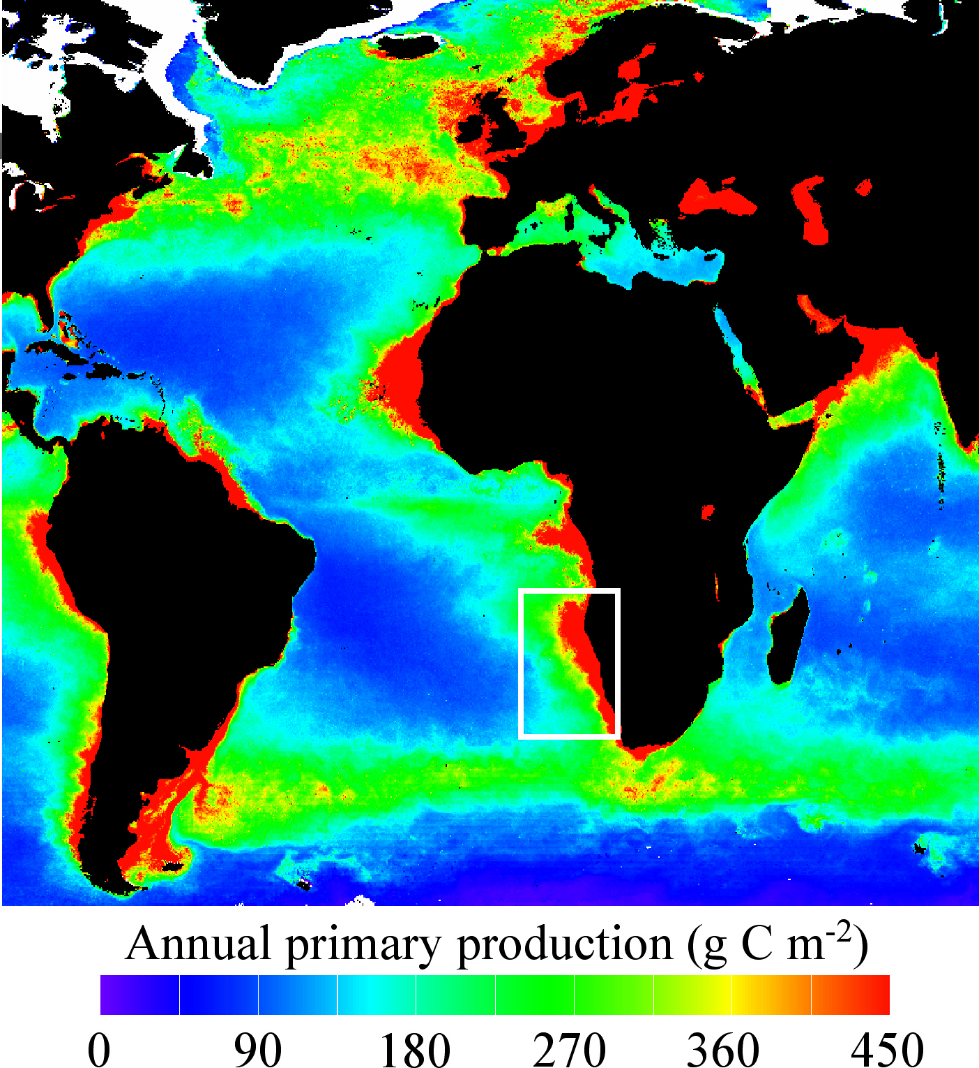
Soft tissue pump: primary production
Annual net primary production
(NPP; g C m⁻² yr⁻¹)
200-450 g C m⁻² yr⁻¹
Kuypers et al. 2005

Slide 5
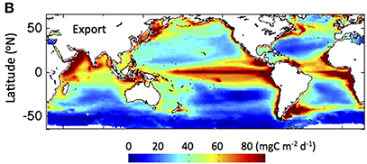
Soft tissue pump: global ocean POC export
Export from the euphotic zone: 10-30 g C m⁻² yr⁻¹
0
7
14
21
28
(g C m⁻² yr⁻¹)
The distribution of POC export roughly matches the distribution of phytoplankton biomass and productivity
Siegel et al. 2014
Notes:
Export production via biological carbon pump important component of global carbon cycle, especially given increases in atmospheric co2 and climate change
phytoplankton fix as much carbon as terrestrial ecosystems but carbon biomass 2 orders of magnitude lower – most production recycled

Slide 6
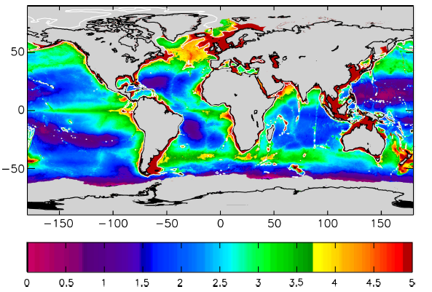
Soft tissue pump: global ocean POC export
Bottom POC flux: 0.1-4 g C m⁻² yr⁻¹ (<1% of NPP)
(g C m⁻² yr⁻¹)

Slide 7
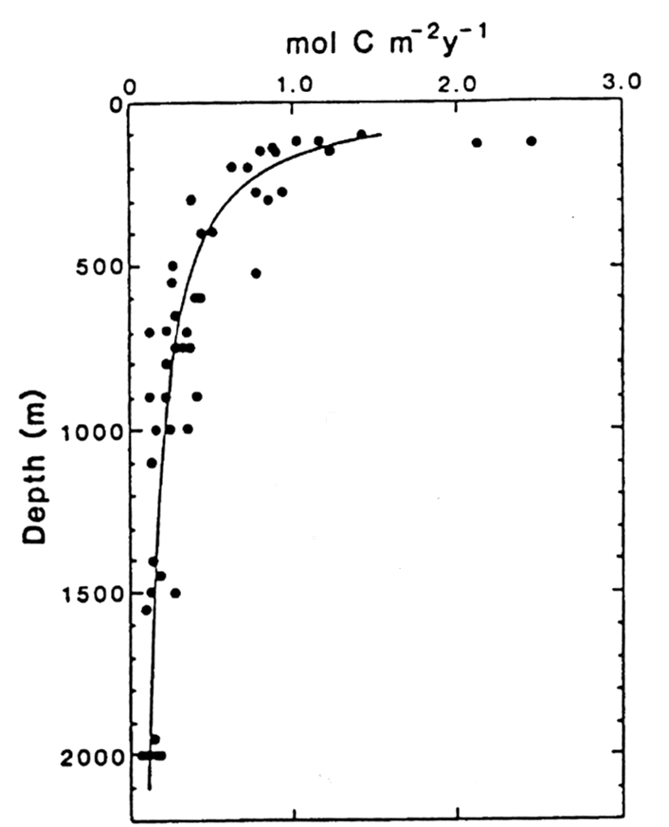
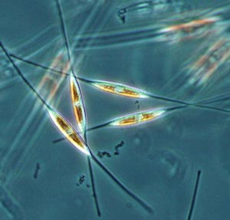
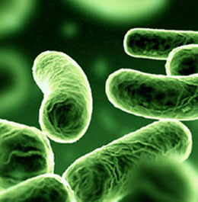
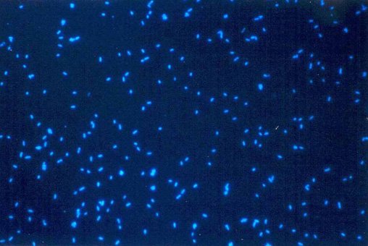
Soft tissue pump: POC flux (Martin curve)
6CO₂ + 6H₂O →
C₆H₁₂O₆ + 6O₂
F_{z} = F₁₀₀(z/100)^{-b}
C₆H₁₂O₆ + 6O₂ →
energy + 6CO₂ + 6H₂O
Martin et al. 1987
Notes:
Flux of organic carbon to depth (remind them that this is a FLUX). I tell them about Martin, famous oceanographer, who first measured this characteristic exponential decay curve for the organic carbon export flux. The reason the curve is shaped like this is because organic carbon is produced in the surface due to photosynthesis, and respired below the sunlit upper euphotic zone. While the value of b (the exponential) changes with ocean region, the shape of the curve is always the same.

Slide 8
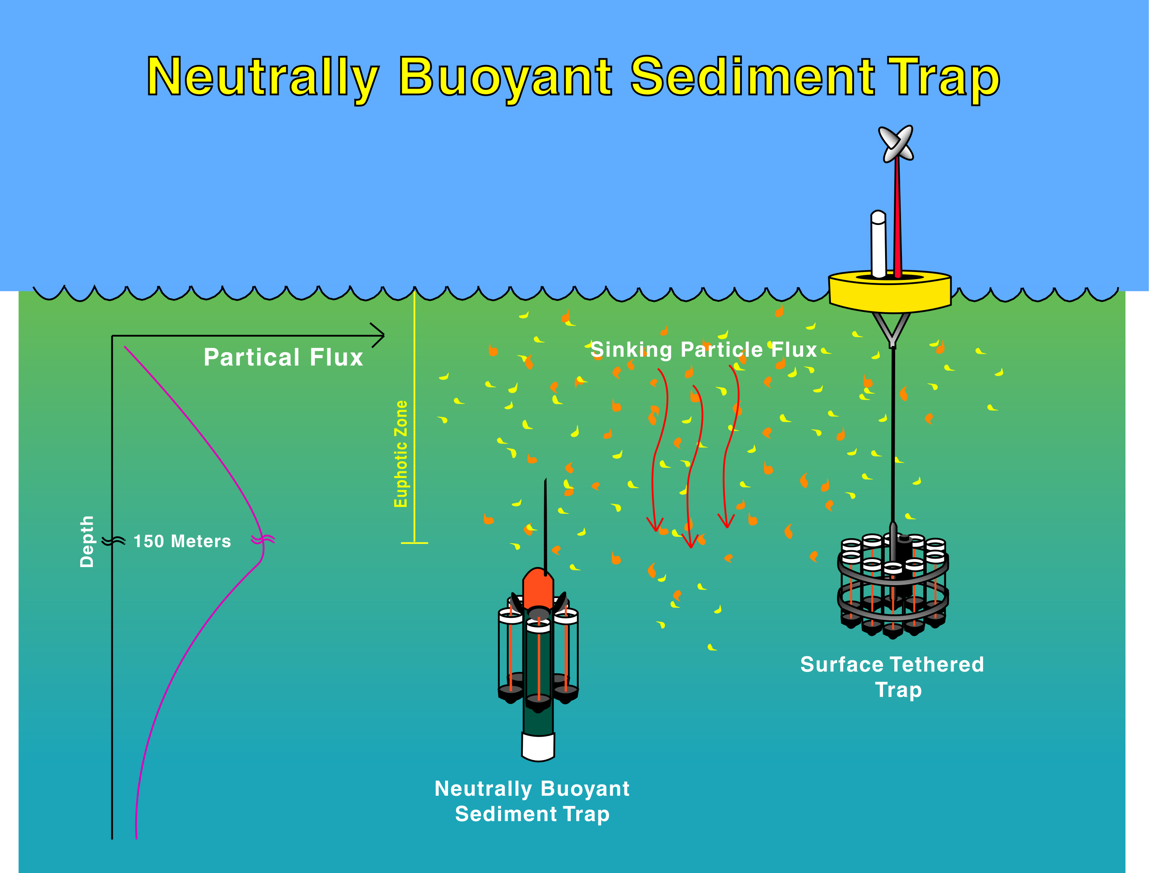
Particle flux: sediment traps
Notes:
Shows how oceanographers measure the POC flux – sediment traps that collect for different periods of time.

Slide 9
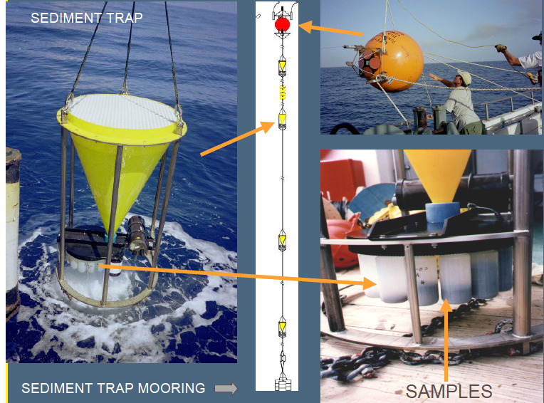
Notes:
This is a moored sediment trap, stays out for a year, with a different sample collected each month.

Slide 10
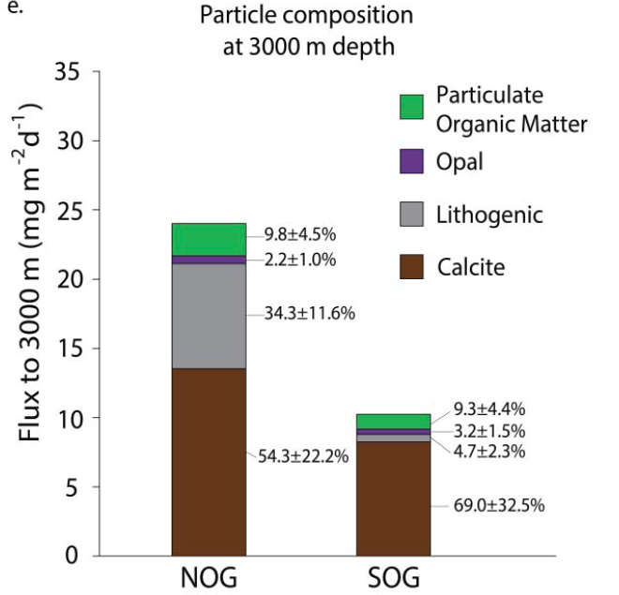
Composition of sediment trap material
CaCO₃
Pabortsava and Lampitt, 2016
Notes:
Organic carbon is not the only thing in the export flux. This is the composition of sediment trap material in the north and south atlantic subtropical gyres, collected at 3000 m. And you can see that there’s a large contribution from CaCO3/calcite (brown). This is due to organism that make calcite shells, for example foraminifera (type of zooplankton) and coccolithophores (type of phytoplankton). *** we’re making the transition here to the carbonate pump ****

Slide 11
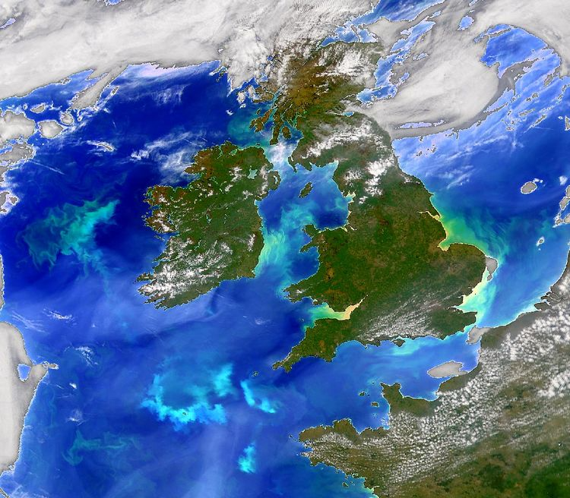
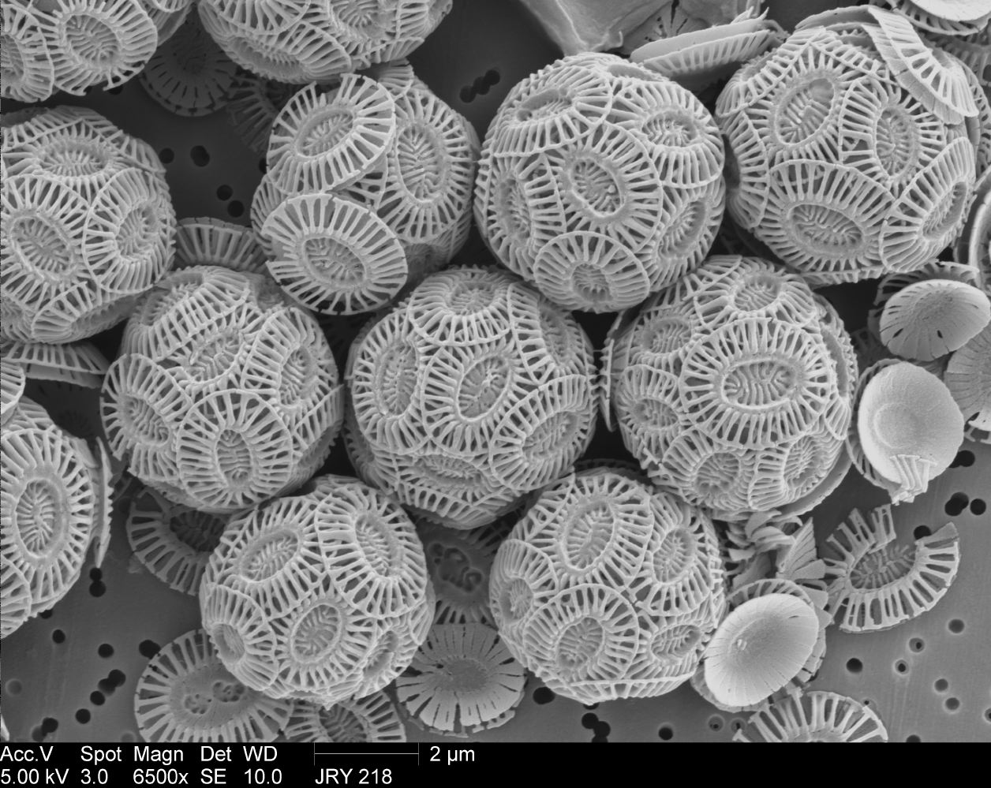
Coccolithophore bloom
Notes:
Here’s a example of the phytoplankton that make their shells from calcium carbonate. The white patches you can see (this is the North Sea, you can see the British Isles) is calcium carbonate because the bloom of coccoliths is so huge.

Slide 12
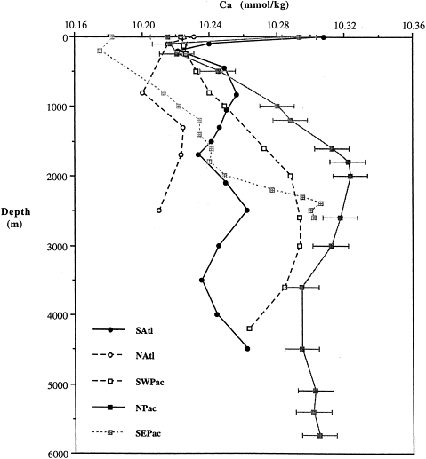
The calcium (Ca) in CaCO₃
[Ca²⁺] (mmol/kg)
Calcium
Depth (m)
Notes:
Concentration of calcium in the ocean – it’s very high, mM range, thus completely non-limiting. The thing that limits the formation of calcium carbonate is therefore the amount of carbonate.

Slide 13
2) Biological carbon pump
The photosynthetic production, sinking, and deep ocean decomposition of organic matter that cause a vertical gradient of dissolved inorganic carbon (DIC) in the ocean, in net causing the storage of CO₂ in deep waters and thus lowering atmospheric CO₂.
In some cases, the biological pump is taken to involve two components: (1) the rain of soft tissue organic carbon from the surface to depth, the “soft tissue pump”, and (2) the rain of mineral calcium carbonate from the surface to depth, the “carbonate pump”. The former (1) lowers atmospheric CO₂, while the latter (2) raises it.
Notes:
Reminder of our definition of the biological carbon pump, which consists of the soft tissue pump and the carbonate pump. You could ask them to tell you what the soft tissue pump is again. The important thing is that while the soft tissue pump lowers atmospheric CO2, the carbonate pump actually raises it. How does that work?

Slide 14
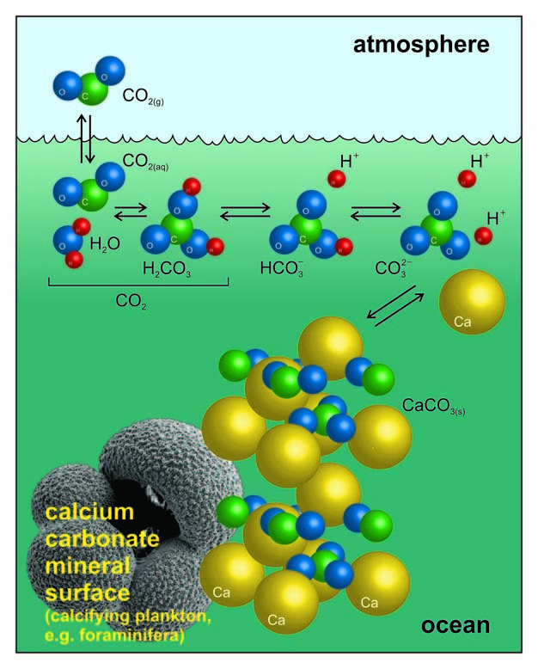
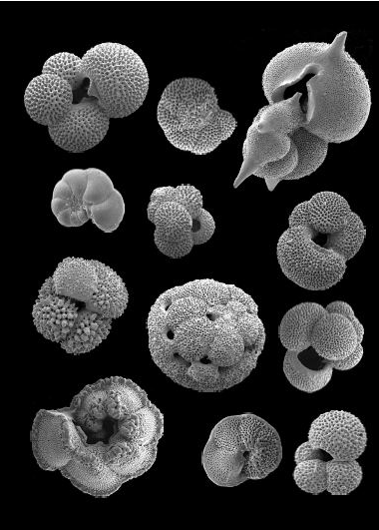
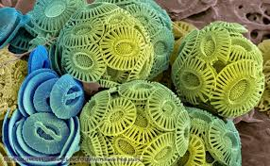
Carbonate pump
Ca²⁺ + 2HCO₃⁻ ↔ CaCO₃ + H₂CO₃
H₂CO₃ ↔ H₂O + CO₂
Ca²⁺ + 2HCO₃⁻ ↔ CaCO₃ + CO₂ + H₂O
Formation of calcium carbonate releases CO₂
foraminifera
Barker and Ridgewell, 2012
Notes:
Calcium in the ocean reacts with bicarbonate to form calcium carbonate (solid) and H2CO3 (carbonic acid)
In the bottom RH corner you see forams (zooplankton) on the left and coccoliths on the right.

Slide 15
Carbonate pump
Ca²⁺ + 2HCO₃⁻ ↔ CaCO₃ + H₂CO₃
H₂CO₃ ↔ H₂O + CO₂
Ca²⁺ + 2HCO₃⁻ ↔ CaCO₃ + CO₂ + H₂O
Formation of calcium carbonate releases CO₂
foraminifera
Barker and Ridgewell, 2012
Notes:
This carbonic acid (H2CO3) very rapidly dissociates into water and CO2.

Slide 16
Carbonate pump
Ca²⁺ + 2HCO₃⁻ ↔ CaCO₃ + H₂CO₃
H₂CO₃ ↔ H₂O + CO₂
Ca²⁺ + 2HCO₃⁻ ↔ CaCO₃ + CO₂ + H₂O
Formation of calcium carbonate releases CO₂
foraminifera
Barker and Ridgewell, 2012
Notes:
If we now balance those two equations, we find that in net, the formation of calcium carbonate releases CO2, working against the solubility pump.

Slide 17
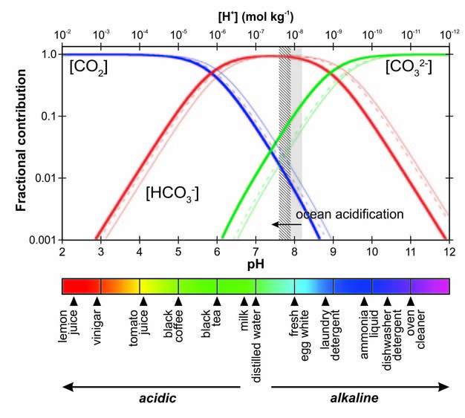
CaCO₃ precipitation removes ionic forms of DIC
decrease pH → increase CO₂
Carbonate pump acts against the soft tissue pump
Notes:
Another way you can think about it is that CaCO3 precipitation removes the ionic forms of DIC, lowers their concentrations, which means we move to the left on this plot. This increases CO2 and lowers pH. Maybe check that they know what pH means.

Slide 18
Difference between soft tissue and carbonate pumps
There is no fundamental need for ocean biology to produce CaCO₃, so flux of CaCO₃:C_{org} may vary greatly, with different implications for CO₂
Notes:
There is an important difference between the soft tissue and carbonate pumps – phytoplankton have to photosynthesize in order to live, which means that ocean biology fundamentally HAVE TO produce organic carbon, such that as long as there is ocean biology, there will be an organic carbon flux and thus a soft tissue pump that lowers CO2. However, the formation of CaCO3 depends on the type of phytoplankton present, which can change. So the relative importance of the carbonate vs. soft tissue pumps can change a lot with time, with implications for atmospheric CO2.

Slide 19
CaCO₃ sinks faster than POC
CaCO₃
Pabortsava and Lampitt, 2016
Notes:
Calcium carbonate is denser than organic matter and sinks rapidly into the deep ocean.

Slide 20
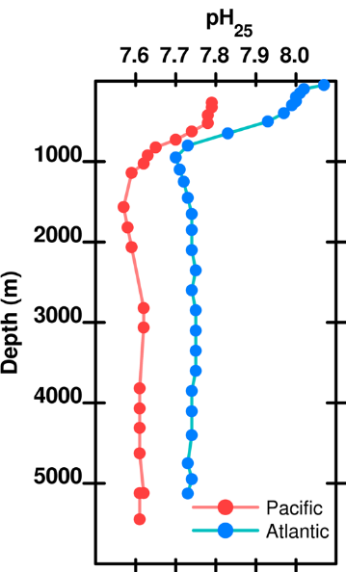
Changes in pH with depth and region
Notes:
As the calcium carbonate sinks, it encounters more corrosive (i.e., lower pH waters) the deeper it gets. Why? (due to the respiration of sinking organic matter than creates CO2, lowers pH). Incidentally, why is the pH in the Pacific lower than the Atlantic?

Slide 21
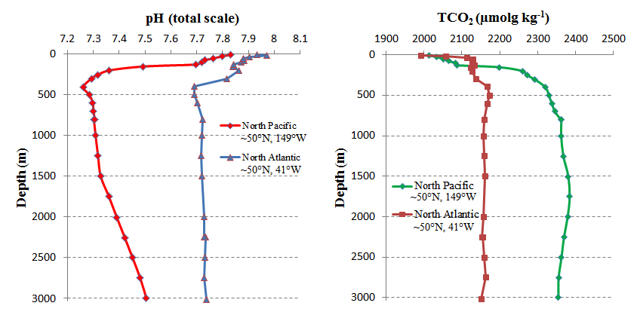
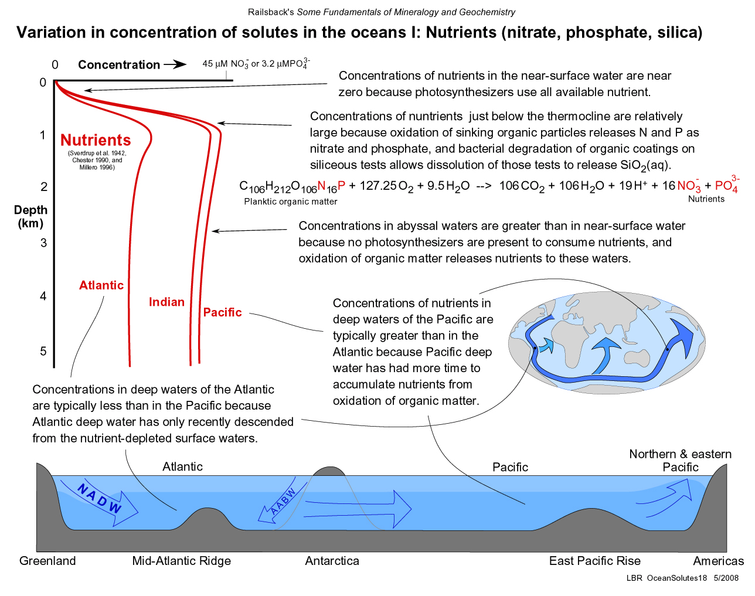
pH
DIC (μmol/kg)
Pacific
Pacific
Atlantic
Atlantic
Atlantic
Pacific
N and E Pacific
Notes:
Shows the the lower pH at depth is due to higher DIC and that DIC is higher in the Pacific because it is further along the ocean conveyor belt and has had more time to accumulate the product of organic matter respiration, which is CO2.

Slide 22
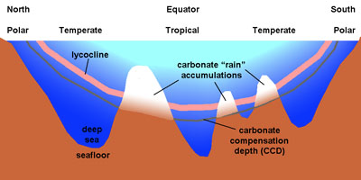
The fate of calcium carbonate
lysocline
Lysocline: CaCO₃ dissolution begins
Notes:
Okay, so to get back to CaCO3 – it rains down into the deep ocean and eventually gets to a depth where the pressure is so high and the pH is so low, that it begins to dissolve. Once dissolution begins, this is known as the lysocline. But just because CaCO3 has started dissolving, doesn’t mean that the net effect is dissolution. The rate of CaCO3 production (i.e., rain of CaCO3 from the surface) is still greater than the rate of dissolution. And so CaCO3 (solid) accumulates. Above the lysocline, the water column is saturated with calcite, which is why CaCO3 can be precipitated out.

Slide 23
The fate of calcium carbonate
lysocline
CCD: CaCO₃ dissolution = CaCO₃ production
Notes:
The depth at which the rate of production = rate of dissolution is called the carbonate compensation depth. Below this, the net effect is one of dissolving CaCO3, so below the CCD, no CaCO3 accumulates. And because CaCO3 is

Slide 24
The fate of calcium carbonate
lysocline
CaCO₃ + CO₂ + H₂O ↔ Ca²⁺ + 2HCO₃⁻
Notes:
And because CaCO3 is dissolving, we get the opposite effect of the carbonate pump, and CO2 is actually consumed/removed.

Slide 25
Biological pump feedbacks
strong biological pump
high flux of POC export
increased respiration
increase in CO₂ concentration
lower pH
shallower CCD
greater volume of CaCO₃ dissolved
more CO₂ consumed (decrease in CO₂)
higher pH
etc.
Notes:
This leads very nicely into alkalinity

Slide 26
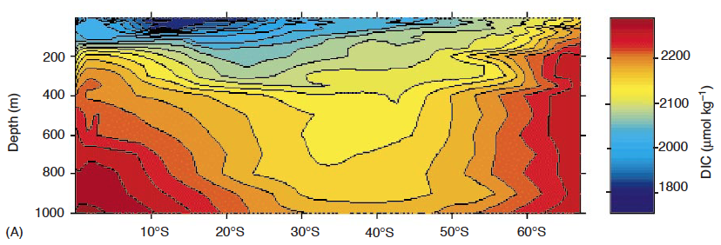
Assignment
This plot from the South Pacific shows a transect of DIC concentration from the equator to the Southern Ocean.
Explain in terms of physics, chemistry, and biology why this plot looks the way it does.
How would you expect this plot to change if the carbonate pump completely shut down?

